Slide 1
The Muscular System:
Part B
10

Slide 2
Deep Muscles of the Thorax: Breathing
Muscles of respiration
External intercostals—more superficial muscles; elevate ribs for inspiration
Internal intercostals—deeper muscles; aid forced expiration
Diaphragm
  Partition between thoracic and abdominal cavities
  Most important muscle in inspiration
  Innervated by phrenic nerves

Slide 3
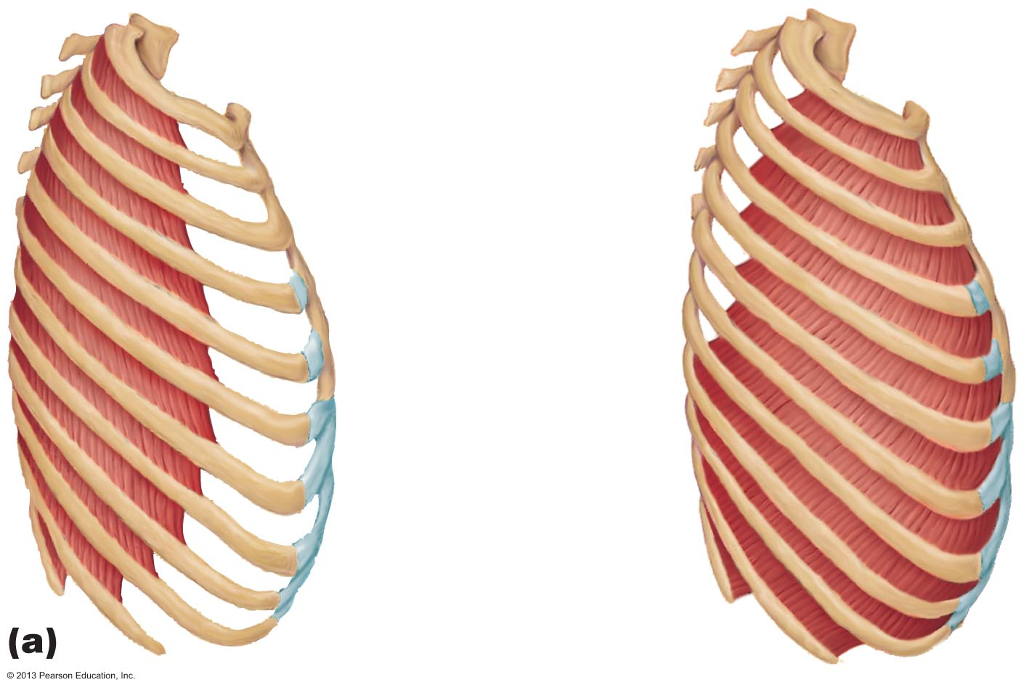
Figure 10.11a Muscles of respiration.
External
intercostal
Internal
intercostal

Slide 4
Muscles of the Thorax
PLAY
A&P Flix™: External intercostals
PLAY
A&P Flix™: Internal intercostals

Slide 5
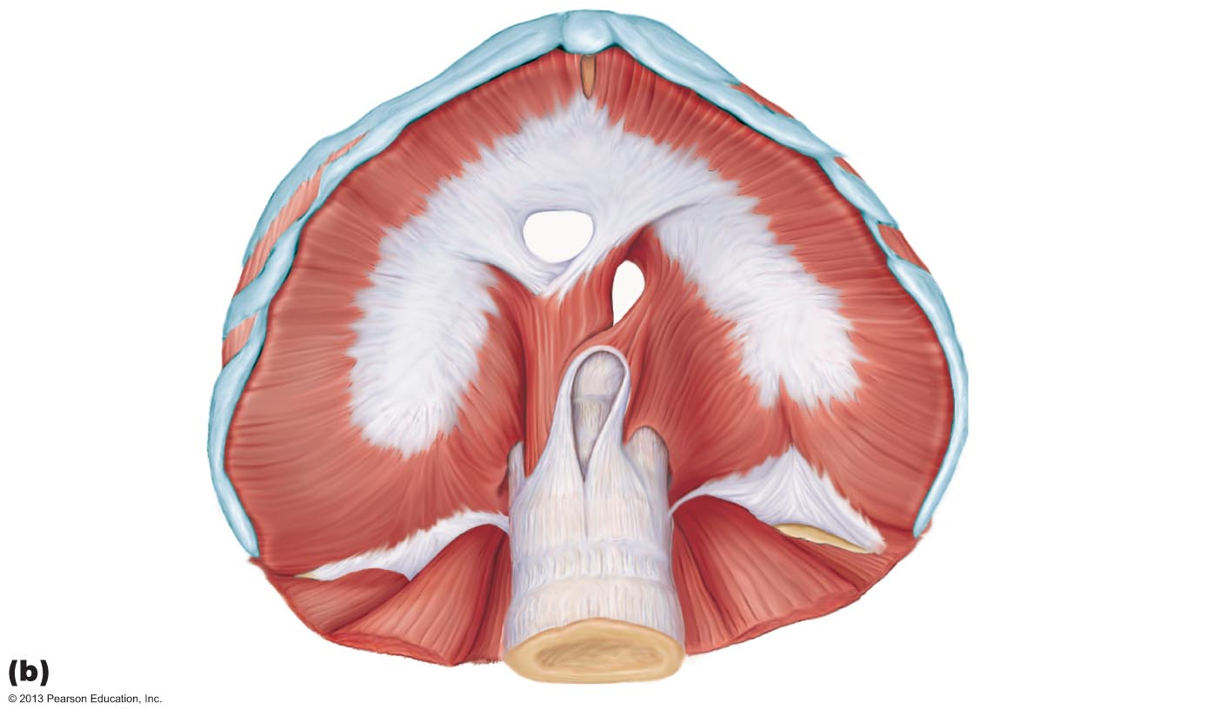
Figure 10.11b Muscles of respiration.
Xiphoid process of sternum
Foramen for inferior
vena cava
Foramen for
esophagus
Costal cartilage
Central
tendon of
diaphragm
Diaphragm
Foramen
for aorta
Lumbar
vertebra
12th rib
Quadratus
lumborum
Psoas major

Slide 6
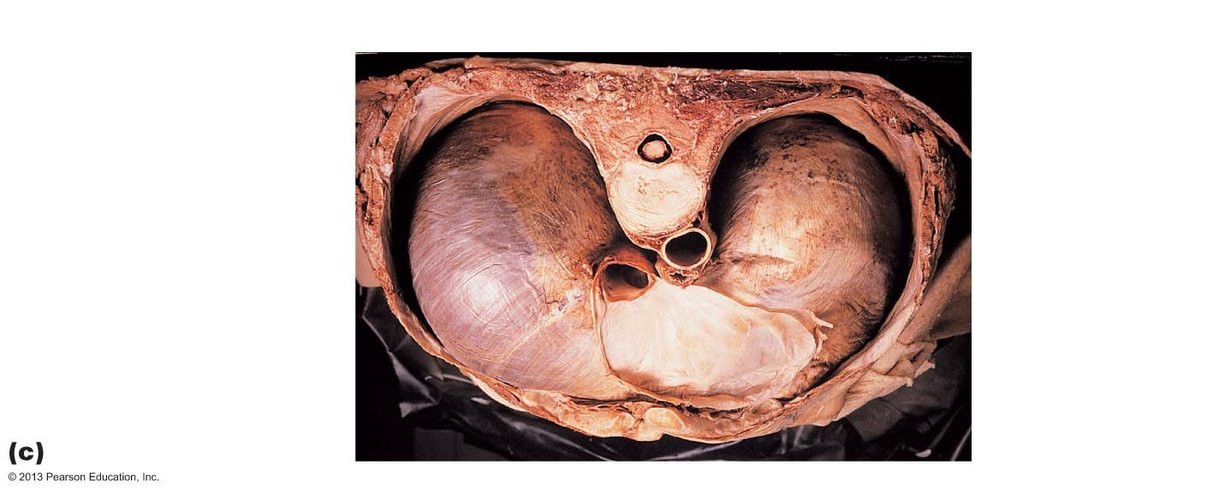
Figure 10.11c Muscles of respiration.
Central tendon of diaphragm
Body of thoracic vertebra
Pericardium (cut)
Aorta
Diaphragm (muscular part)
Inferior vena cava
Esophagus
Pericardial sac

Slide 7
Muscles of the Abdominal Wall
Four paired muscles, their fasciae and aponeuroses form lateral and anterior abdominal wall
  Rectus abdominis
  External obliques
  Internal obliques
  Transversus abdominis

Slide 8
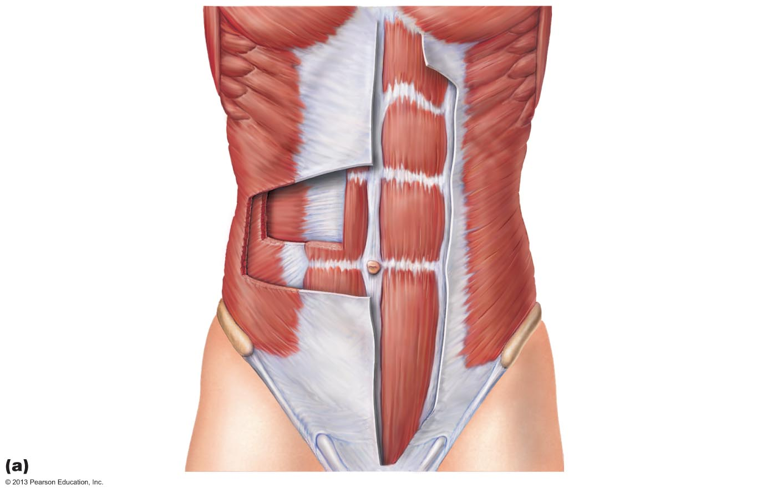
Figure 10.12a Muscles of the abdominal wall.
Pectoralis major
Serratus anterior
Linea alba
Tendinous intersection
Transversus abdominis
Rectus abdominis
Internal oblique
External oblique
Aponeurosis of the external oblique
Inguinal ligament
(formed by free inferior
border of the external oblique aponeurosis)

Slide 9
Muscles of the Abdominal Wall
Fascicles run at angles to one another, provide added strength
All innervated by intercostal nerves
Actions of these muscles
  Lateral flexion and rotation of trunk
  Help promote urination, defecation, childbirth, vomiting, coughing, and screaming

Slide 10
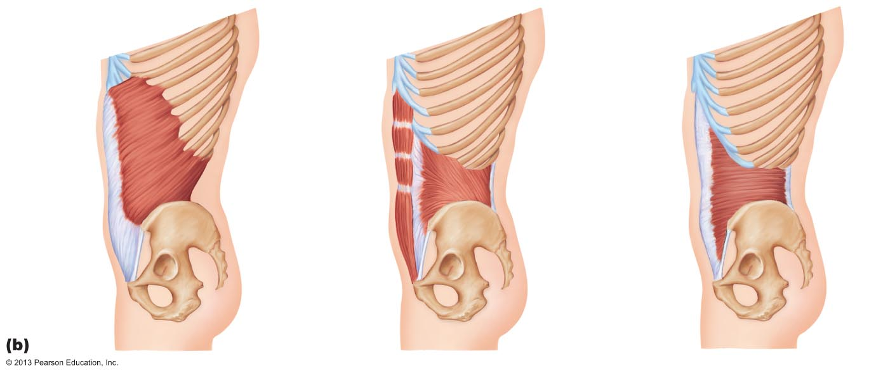
Figure 10.12b Muscles of the abdominal wall.
Rectus abdominis
Lumbar fascia
External oblique
Internal oblique
Lumbar fascia
Iliac crest
Transversus
abdominis
Inguinal ligament
Pubic tubercle

Slide 11
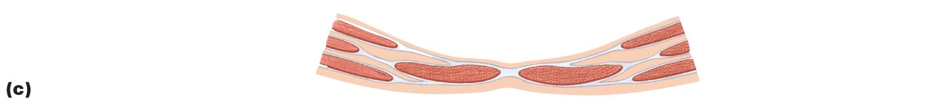
Figure 10.12c Muscles of the abdominal wall.
Transversus abdominis
Peritoneum
Linea alba
Rectus abdominis
External oblique
Internal oblique
Aponeuroses
Skin

Slide 12
Muscles of the Abdominal Wall
PLAY
A&P Flix™: External obliques
PLAY
A&P Flix™: Internal obliques
PLAY
A&P Flix™: Rectus abdominis
PLAY
A&P Flix™: Transversus abdominis

Slide 13
Muscles of the Pelvic Floor
Pelvic floor (pelvic diaphragm) composed of two paired muscles
  Levator ani
  Coccygeus
Both innervated by sacral nerves

Slide 14
Muscles of the Pelvic Floor
Functions of pelvic diaphragm
  Seals inferior outlet of pelvis
  Supports pelvic organs
  Lifts pelvic floor to help release feces
  Resists increased intra-abdominal pressure

Slide 15
Muscles of the Perineum
Urogenital diaphragm
  Anterior half of perineum, inferior to pelvic floor
  Deep transverse perineal muscle
  Contains external urethral sphincter (voluntary control of urination)

Slide 16
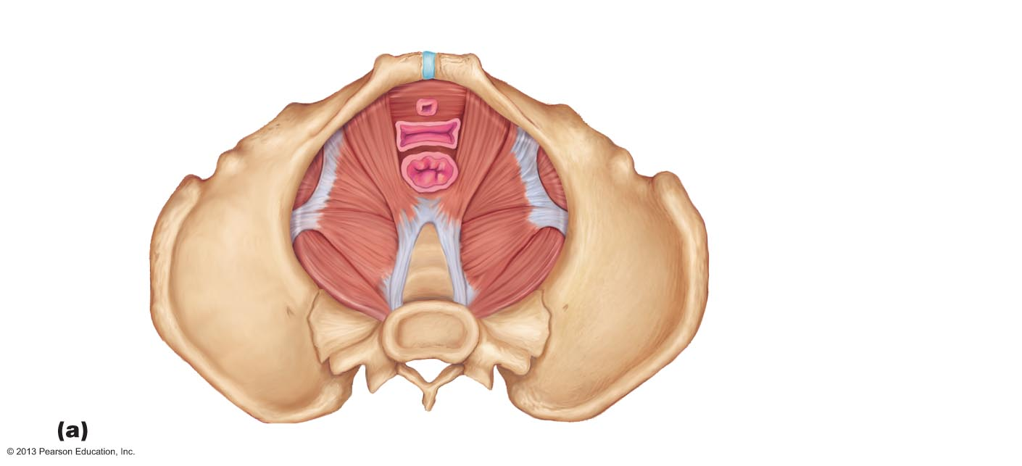
Figure 10.13a Muscles of the pelvic floor and perineum.
Anterior
Pubococcygeus
Symphysis pubis
Levator ani
Iliococcygeus
Urogenital diaphragm
Urethra
Vagina
Anal
canal
Obturator
internus
Coccyx
Piriformis
Levator ani
Pelvic
diaphragm
Coccygeus
Posterior

Slide 17
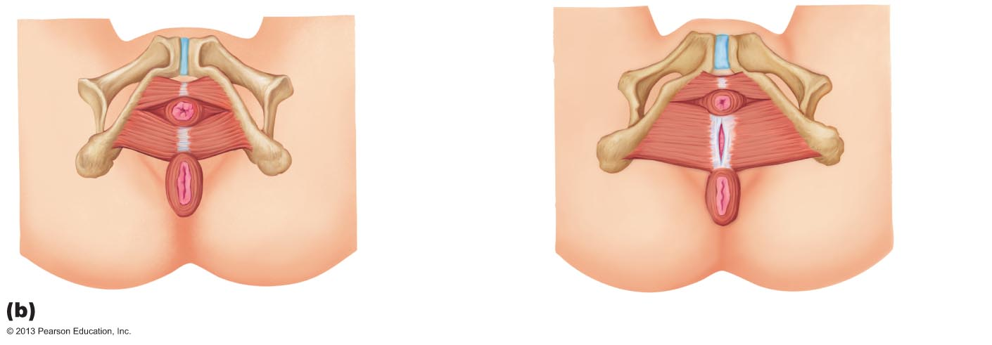
Figure 10.13b Muscles of the pelvic floor and perineum.
Inferior pubic ramus
External
Urethral
sphincter
Urethral
opening
Deep
transverse
perineal muscle
Vaginal
opening
Central tendon
Anus
External
anal sphincter
Male
Female

Slide 18
Muscles of the Pelvic Floor and Perineum
Muscles of superficial perineal space
  Ischiocavernosus
  Bulbospongiosus
  Superficial transverse perineal muscles
External anal sphincter in posterior half of perineum

Slide 19
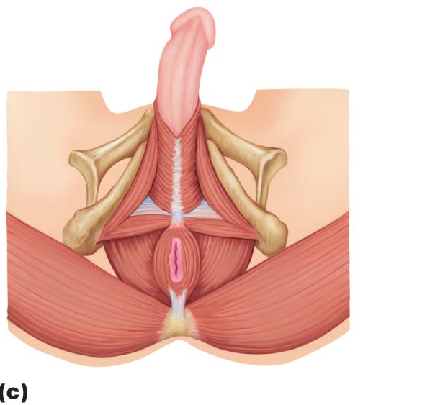
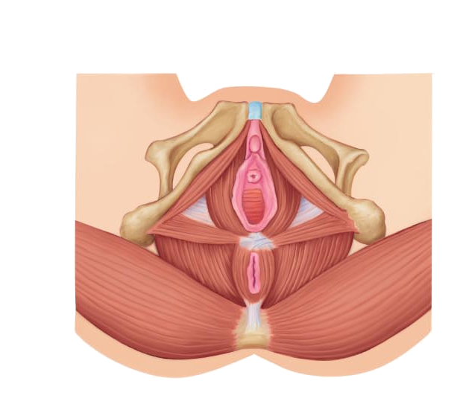
Figure 10.13c Muscles of the pelvic floor and perineum.
Penis
Midline raphe
Ischiocavernosus
Clitoris
Urethral
opening
Bulbospongiosus
Vaginal
opening
Superficial
transverse perineal muscle
Levator ani
Gluteus maximus
Male
Anus
Female

Slide 20
Superficial Muscles of the Thorax
Most - extrinsic shoulder muscles
  Act in combination to fix shoulder girdle (mostly scapula); move it to increase range of arm movements
  Actions - elevation, depression, rotation, lateral and medial movements, protraction, and retraction
Two groups of muscles: anterior and posterior
PLAY
A&P Flix™: Muscles that act on the shoulder joint
and humerus: An overview (a)
PLAY
A&P Flix™: Muscles that act on the shoulder joint
and humerus: An overview (b)

Slide 21
Superficial Muscles of the Thorax
Muscles of anterior thorax
  Pectoralis minor
  Serratus anterior
  Subclavius
PLAY
A&P Flix™: Muscles of the pectoral girdle (a)
PLAY
A&P Flix™: Muscles of the pectoral girdle (b)

Slide 22
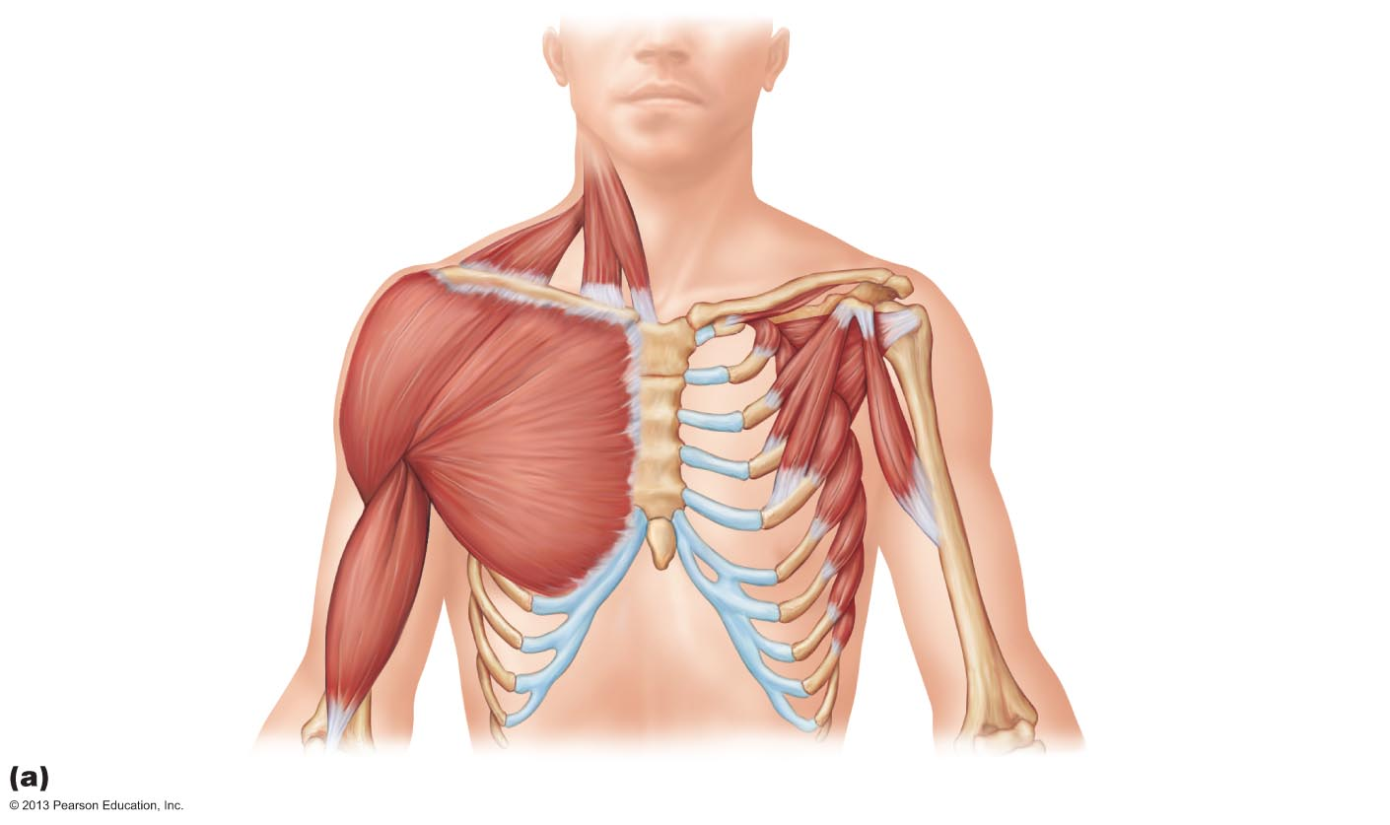
Figure 10.14a Superficial muscles of the thorax and shoulder acting on the scapula and arm.
Sternocleidomastoid
Subclavius
Clavicle
Deltoid
Subscapularis
Pectoralis minor
Pectoralis major
Coracobrachialis
Sternum
Serratus anterior
Biceps brachii
Humerus
PLAY
A&P Flix™: Muscles that act on the shoulder joint
and humerus: An overview (b)

Slide 23
Superficial Muscles of the Thorax
PLAY
A&P Flix™: Pectoralis minor
PLAY
A&P Flix™: Serratus anterior

Slide 24
Superficial Muscles of the Posterior Thorax
Posterior extrinsic shoulder muscles
  Trapezius
  Levator scapulae
  Rhomboids (major and minor)
PLAY
A&P Flix™: Muscles of the pectoral girdle (c)
PLAY
A&P Flix™: Movement of the pectoral girdle

Slide 25
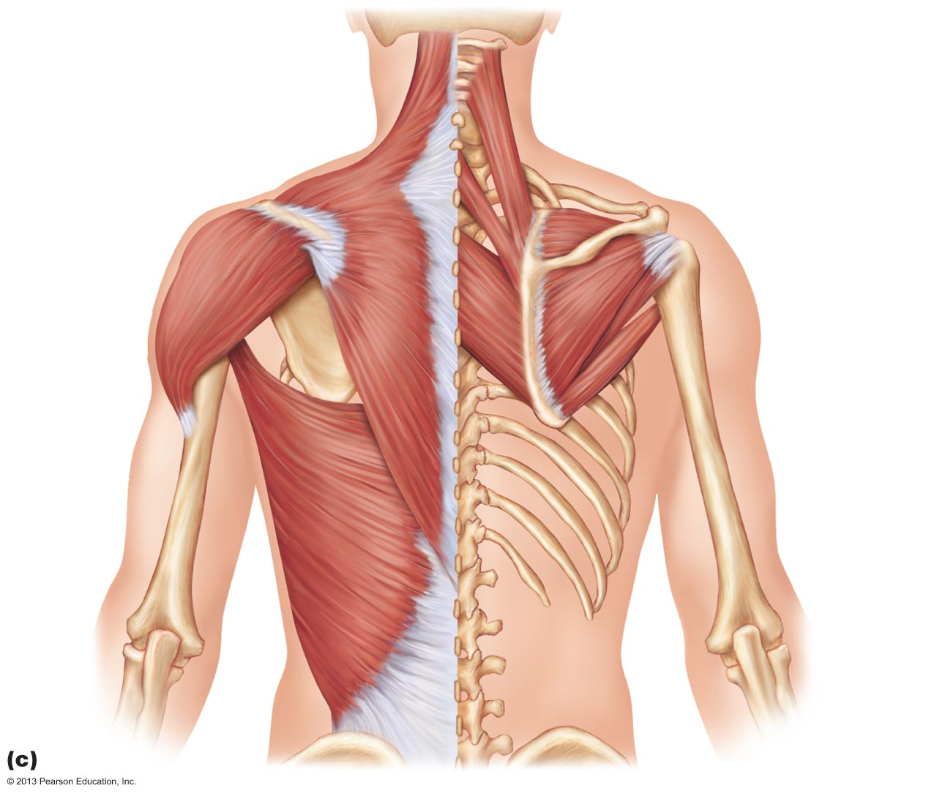
Figure 10.14c Superficial muscles of the thorax and shoulder acting on the scapula and arm.
Levator
scapulae
Trapezius
Supraspinatus
Clavicle
Deltoid
Spine of
scapula
Rhomboid
minor
Infraspinatus
Rhomboid
major
Teres minor
Teres
major
Humerus
Latissimus
dorsi

Slide 26
Superficial Muscles of the Posterior Thorax
PLAY
A&P Flix™: Trapezius
PLAY
A&P Flix™: Levator scapula
PLAY
A&P Flix™: Rhomboid major
PLAY
A&P Flix™: Rhomboid minor

